Slide 1
Manufacturing
Downtime
Project
Data analysis project
Supervised by: Eng/ Kareem Bakli

Slide 2
Contents of this Presentation
1. Case Study Story | 6. Dashboard
2. Data Exploration Data | 7. Predictive Maintenance Triggers
3. Business Questions | 8. Recommended Action Plan
4. Data Transformation Ideas | 9. Project Impact
5. Insights

Slide 3
Case Study Story

Slide 4
Data Analysis Team
Rania Mohamed El-wany
Aya Emad Abd Al-manum
Team Leader
Israa Nagy Mohamed
Mayada Kairy Mohamed
Toka Ahmed El-sayed
Hend Adel Ahmed Wafa

Slide 5

LatheTech Industries came to us with a challenge:
"Our machines are experiencing unexpected breakdowns, which heavily impact productivity and increase costs."
Reported Issues
01
02
03
Excessive Tool Wear
High Downtime
& Costs
Heat & Power Issues
“And then we started with understanding the metadata, then the business questions, followed by exploring the data, preparing clearing transforming, and finally uncovering actionable insights.”

Slide 6
Objective
    Analyze machine failures
    Identify root causes behind downtime
    Build automated Power BI dashboard
    Predict high-risk operating conditions
    Recommend proactive maintenance actions

Slide 7
Data
Exploration

Slide 8

Dataset purpose
This dataset represents the operating conditions of industrial machines and whether they failed. data used in predictive maintenance: predicting and preventing machine breakdowns before they occur.
Number of rows: 10,000
Number of columns: 15
“During data exploration, we found that the dataset contained no null or missing values or duplicates which simplified preprocessing.”
Data Description:

Slide 9
Text
Numeric
Text
Binary(0/1 Flags)
  Type
  Type
  UDI
  Air temperature [K]
  Process temperature [K]
  Rotational speed [rpm]
  Torque [Nm]
  Tool wear [min]
  Downtime (min)
  Machine failure
  TWF
  HDF
  PWF
  OSF
  RNF
Date
Date
  Date
  Date
Data Description:

Slide 10
Data dictionary:
Column | Description | Why it matters
UID | Unique identifier for each record. Just a running number. | Used to reference rows, not useful for analysis.
Product ID | Identifies the product being manufactured, including its quality and a variant-specific serial number grade (Low, Medium, High). | Different product qualities may affect wear and failure.
Type | Quality grade of the product: L = Low, M = Medium, H = High. | Higher-quality products may last longer.

Slide 11
Data dictionary:
Air temperature [K] | Temperature of the surrounding air (in Kelvin). | Hotter air may reduce cooling efficiency and cause overheating.
Process temperature [K] | Temperature inside the machine during operation (in Kelvin). | Higher process temperatures increase stress on components.
Rotational speed [rpm] | How fast a rotating part moves, in revolutions per minute. | Very high or low speeds may lead to stress or poor performance.
Torque [Nm] | Twisting force applied by the machine, in Newton-meters. | Higher torque can increase strain on parts.
Tool wear [min] | How long the tool has been used, measured in minutes. | As wear increases, tools are more likely to fail.
Machine failure | Did the machine fail at this moment? 0 = No, 1 = Yes. | The main target variable for prediction.

Slide 12
Data dictionary:
TWF (Tool Wear Failure) | Did the machine fail due to worn-out tools? | Shows a specific failure cause.
HDF (Heat Dissipation Failure) | Did the machine fail because heat couldn’t be removed properly? | Related to air vs. process temperature differences.
PWF (Power Failure) | Did the machine fail due to power issues? | Occurs if power output is too high/low.
OSF (Overstrain Failure) | Did the machine fail because of overstrain (too much force on a worn tool)? | Combination of torque + tool wear.
RNF (Random Failure) | A failure that occurs randomly, not explained by conditions. | Mimics real-life unpredictable failures.
Date/Time | Timestamp of when the record was taken. | Enables time-based analysis, trends, and prediction windows.

Slide 13
Business Question
Core Questions
Diagnostic Questions
Perspective Questions

Slide 14
Core Questions
Focus :
What happened? Simple KPIs, counts, averages.
Questions
    1. What is the average time between failures for the machines?
    2. Which failures (TWF, HDF, PWF, OSF, RNF) are most common, and which cause the longest downtime?

Slide 15
Diagnostic Questions
Focus :
Relationships, patterns, root causes.
Questions
1. Do certain operating conditions increase the risk of failure?
2. Which parameter is the strongest driver of failures?
3. Are there patterns (after a tool wear threshold) where efficiency drops before failure?
4. Do some machines fail more often than others? Why?
5. Do certain failure types tend to happen together more often than by chance?

Slide 16
Perspective Questions
Focus :
Predictive + recommended actions.
Questions
Can we predict when the next failure is likely to happen?
What is the optimal time to perform maintenance before failures occur?
How many failures could be prevented if maintenance is scheduled proactively (e.g. after 200 min of tool wear)?
What is the probability of failure in the next 24 hours given current conditions?
Are there early warning signals (patterns in torque/air temperature) that could trigger alerts to avoid big breakdowns?

Slide 17
Data Transformation Ideas

Slide 18
1. Unpivot Failure Modes
2. Power = Torque × Rotational Speed (explicitly calculate it as a column).
3. Temp difference = Process temperature − Air temperature (important for HDF).
4. Tool wear classification
Example:
Bin tool wear into ranges: Low (<100 min), Medium (100–200), High (>200).
Low (<100), Medium (100–200), High (200-240), Critical (>240)”
5. Temp_Diff_Category = Safe (>9), Warning (8.6–9), Risk (<8.6)
6. Power_Category = Safe (3500–9000W), Risk (outside this range)
7. OSF_Category = Safe (<threshold), Risk (≥threshold)
8. Risk_Level = Safe / Medium Risk / High Risk / Failure
9. Utilization Rate= [Power] / 9000
10. Utilization Category :(Under loaded / Optimal / Overloaded).
Utilization Rate >0.4 (Under loaded) , <= 0.9(Optimal ) , else (Overloaded)

Slide 19
Extract features from datetime
11. Hour of day
(morning, evening, night).
12. Shift
(e.g., divide 24h into 3 shifts: 0–8, 8–16, 16–24).
13. Month / Season.
14. Failure lead time
a target like “failure within the next N hours” instead of “failure now.”

Slide 20
Insights

Slide 21
Insights
Failure distribution
% of machines failed vs not failed
Which failure modes are most common
Failure by product type (L/M/H)
Time patterns of failures (day vs night, shift analysis)
Seasonality or environment effects (daily cycle, summer vs winter)
Random failures (RNF) — frequency compared to other failures
Relationship between tool wear and failures (thresholds)
Speed–torque–power relationships (does extreme power correlate with PWF?)

Slide 22
Dashboard

Slide 23
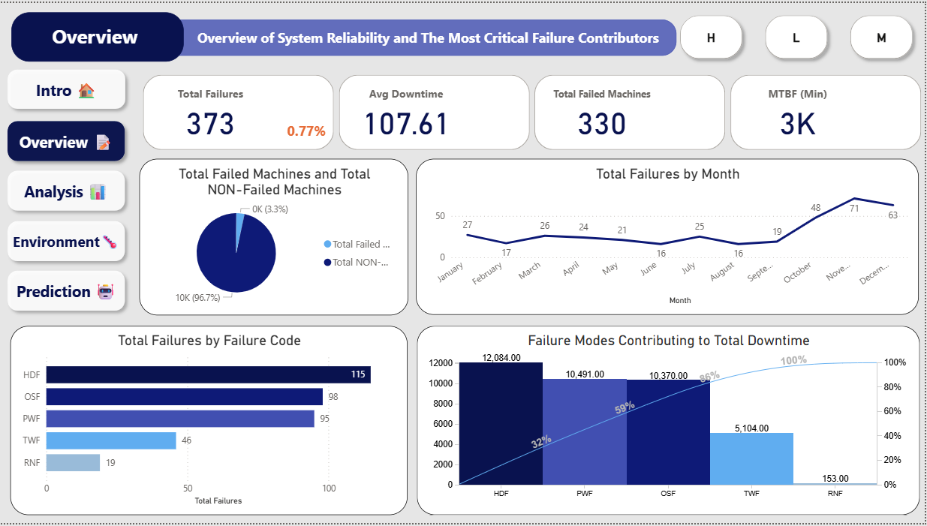

Slide 24
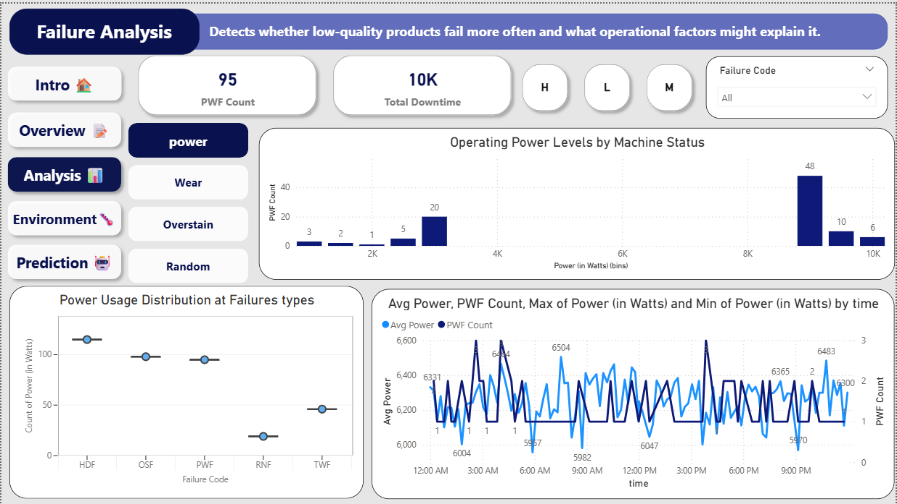

Slide 25
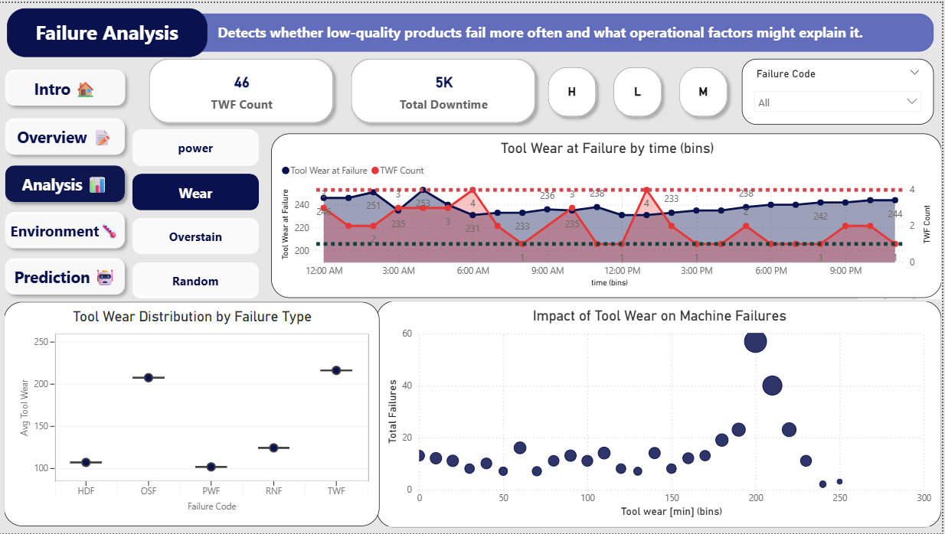

Slide 26
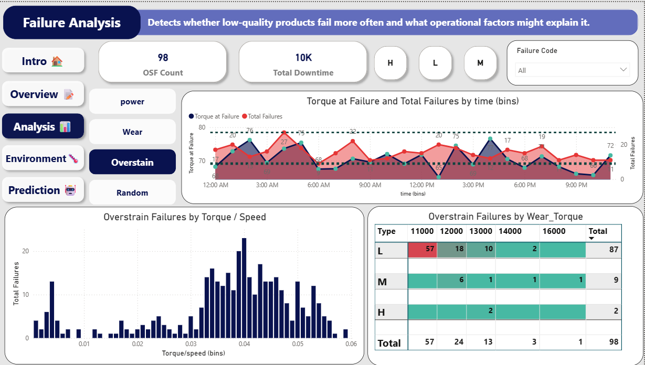

Slide 27
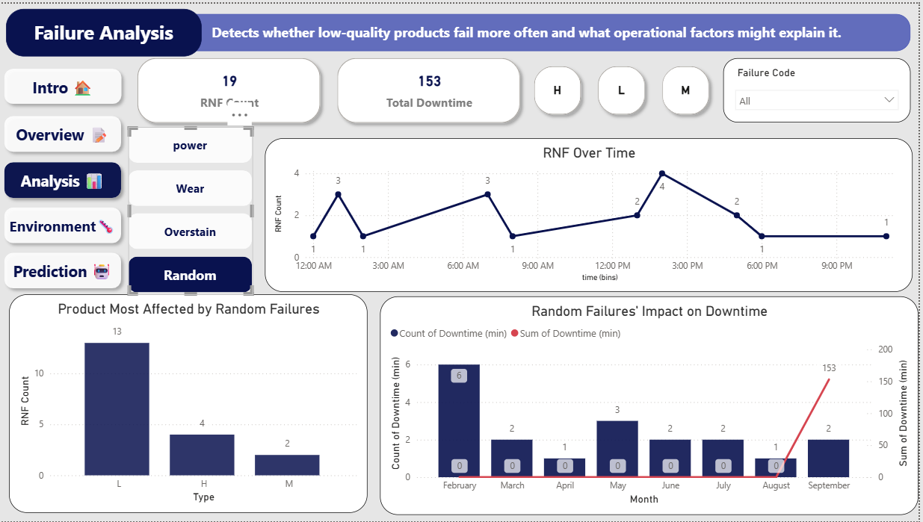

Slide 28
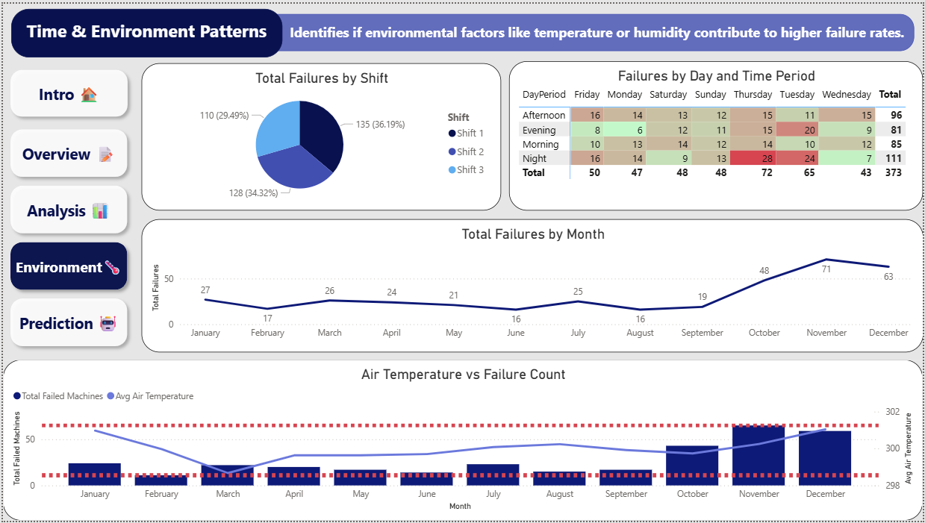

Slide 29
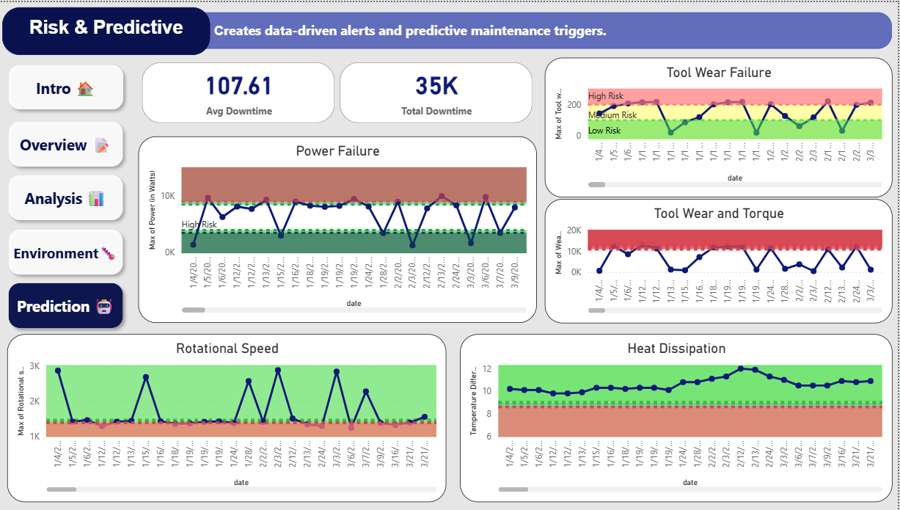

Slide 30
Predictive Maintenance Triggers

Slide 31
To transition to a proactive maintenance model, alerts should be set at the boundary of the Medium/High Risk zones to enable intervention before failure occurs.
Failure Mode | Threshold | Action
Power Failure | <3.5K or >9K | Stabilize power
Tool Wear | >200 min | Replace tool
OSF (Wear_Torque) | >11K L / 12K M / 13K H | Reduce load
Rotational Speed | <1380 | Check load
Temp Diff | <8.6 | Cooling action

Slide 32
Recommended Action Plan

Slide 33
  Immediate Focus (Highest Priority)
# | Objective | Proposed Action (Based on Prediction) | Key Performance Indicators (KPIs)
1 | Stabilize Power (PWF) | Install Voltage Regulators or UPS Units for critical machines to buffer against sharp spikes (>9K W) and dips (<3.5K W). | Decrease in red zone breaches on the Max Power chart.
2 | Manage Tool Wear (TWF) | Implement an automated Power BI alert that triggers a Tool Replacement Work Order when wear exceeds 200 minutes. | Increase in Mean Time Between Failures (MTBF); 50% reduction in TWF incidents.
3 | Mitigate Overstrain (OSF) | Review operational programs that generate Wear_Torque levels above 11K on Type L products; enforce maximum load limits during peak OSF hours (3 PM/9 PM). | Decrease in OSF incidents for Type L products.

Slide 34
  2. Mid-Term / Environment & Process Focus
# | Objective | Proposed Action (Based on Report Findings) | Key Performance Indicators (KPIs)
4 | Improve Operating Environment | Install supplementary cooling in the machine area, specifically ahead of the high-risk season (September to December). | Decrease in failure correlation with ambient air temperature in Q4.
5 | Review Shift Procedures | Conduct an audit of the operations, training, and supervision during Shift 3 and the Night period to identify operational gaps contributing to high failure rates. | Decrease in Shift 3's contribution to total failure incidents.

Slide 35
Project Impact

Slide 36
Clear visibility on root causes (90% downtime explained)
Automated monitoring instead of manual analysis
Predictive thresholds to prevent failures
Expected improvement in MTBF
Early warnings = lower cost of maintenance

Slide 37
Thanks!
Do you have any questions?

